Slide 1

Blockchain for AI
A Transparent and Provably Fair AI-Based Ethereum Lottery System
By Rajrup Banerjee
Stream: CSE(CSBS)
Enrollment ID: 12020002018047
Class Roll: 41
GitHub Link

Slide 2
Abstract
Lotteries have a long history of being a beloved form of entertainment for players all around the world. However, problems with openness, justice, and trust have frequently plagued conventional lottery systems. The Transparent and Provably Fair AI-based Ethereum Lottery System is a novel use of blockchain and artificial intelligence (AI) technology that is introduced in this study. The main goals of this system are to assure fairness, increase security and promote user participation.

Slide 3
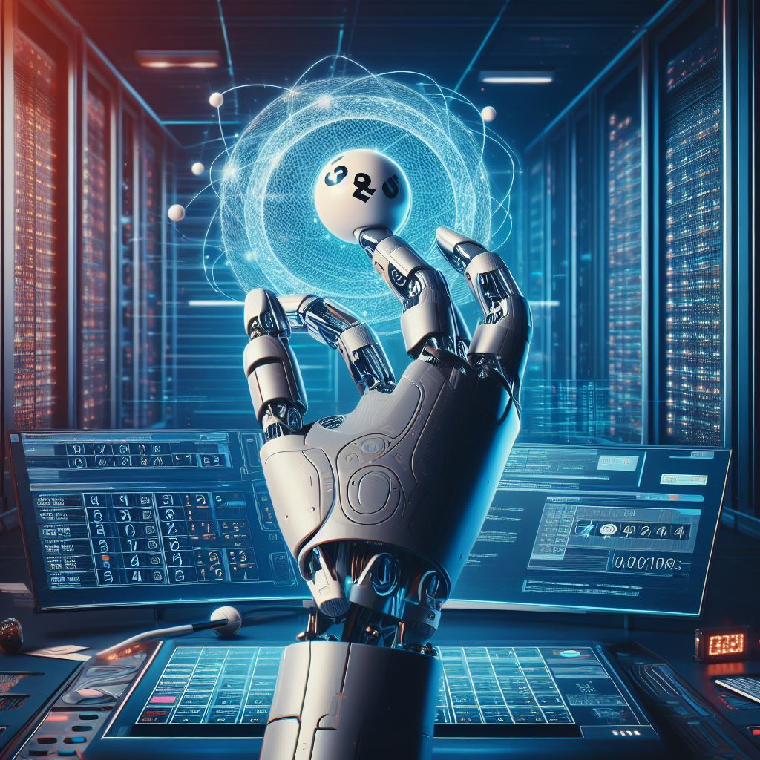
Introduction:-
Millions of people participate in various types of lotteries across the world. The lack of openness in conventional lottery systems, however, frequently raises questions about fraud and manipulation. This project was started in order to address these issues by developing a lottery system that is genuinely transparent and equitable using blockchain technology and AI.

Slide 4

What is Blockchain:-
Enhanced collaboration and communication among project stakeholders
Improved project visualization and virtual walkthroughs
Clash detection and reduced errors in design
Increased efficiency in construction scheduling and cost estimation
Simulations and analysis for energy efficiency and sustainability

Slide 5

Objectives of Lottery System:-
Transparency: To provide a lottery system where all operations are transparently recorded on the Ethereum blockchain, allowing anyone to verify the fairness of the process.
Fairness: To ensure that the lottery's random number generation process is provably fair and cannot be manipulated.
Security: To protect user funds and data through robust security measures.
User Participation: To make it easy for users to participate in the lottery by purchasing tickets with Ether.
Compliance: To adhere to legal and regulatory requirements in the operation of a lottery.

Slide 6
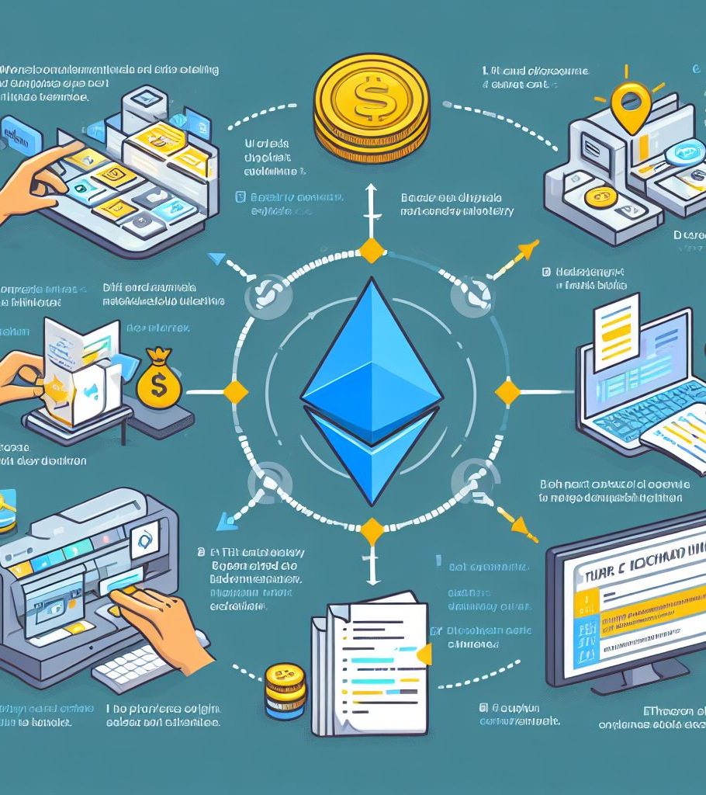
Brief Overview of Ethereum:-
The decentralized blockchain platform Ethereum is used to build decentralized apps by using smart contracts. It runs on a vast network of nodes, giving code execution a safe and secure environment.
Advantages:-
Security: Ethereum's blockchain is highly secure and resistant to tampering.
Transparency: All transactions are publicly recorded, ensuring transparency.
Immutability: Once deployed, smart contracts cannot be altered, ensuring the integrity of lottery rules.
Global Reach: Ethereum is accessible to anyone with an internet connection, enabling a global user base.

Slide 7
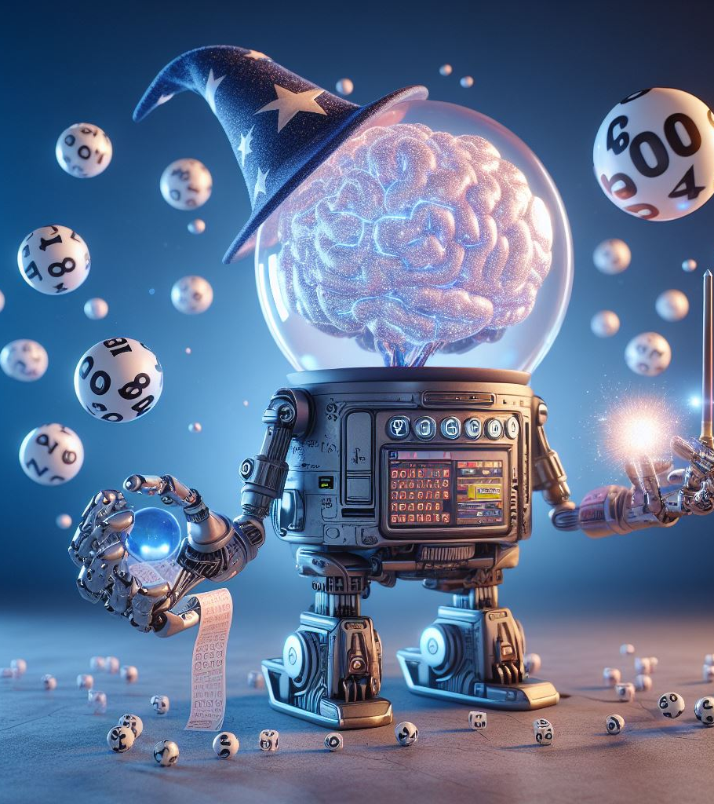
System Architecture Overview
The lottery system's architecture consists of
Ethereum Blockchain: For smart contract execution.
AI Module: For generating winning numbers.
User Interfaces: For ticket purchase and result verification.
Role of AI in Generating Winning Numbers
AI algorithms are used to generate winning numbers in a provably random and fair manner. Algorithms are selected based on their randomness and fairness criteria, ensuring that no entity can predict or manipulate outcomes.
Security Considerations
Security is given careful consideration, and measures have been taken to prevent fraud, vulnerabilities, and data breaches. User data is managed and maintained securely at all times.

Slide 8

Creating the Lottery Smart Contract
A lottery smart contract is developed using the Solidity programming language. The contract includes functions for ticket purchases, random number generation, and prize distribution.
Implementing Random Number Generation with AI
AI algorithms are integrated into the smart contract to ensure random and fair number generation. This involves code examples and explanations of how randomness is achieved.
Ensuring Transparency through the Blockchain
Every transaction and operation within the lottery system is recorded on the Ethereum blockchain. This allows participants to independently verify the fairness of the process.

Slide 9
Conclusion
In summary, the Transparent and Provably Fair AI-Based Ethereum Lottery System combines blockchain and AI to offer a transparent, secure, and accessible lottery experience. This project not only addresses long-standing issues of fairness and transparency in traditional lotteries but also demonstrates the potential of emerging technologies to reshape the industry. With a strong focus on user trust and ethical practices, it stands as a trailblazing solution in the world of lottery systems.

